Slide 1

Scope and keywords

Slide 2
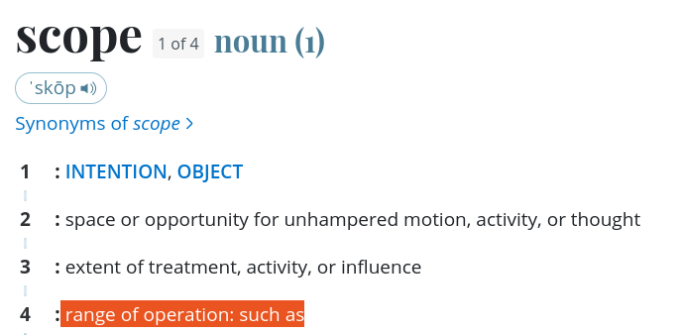
Scope
Scope is the extent to which something can be done, in programming the scope is the extent of things that either a function or class or things has access to.
You can access another class’ variables from another class, since they are out of scope. You have to ask for them to bring them into your scope.
Main
function
class

Slide 3
Scope in classes
Inside a class you can assign weather something is private, public or protected using keywords, this give different scopes to different things.
With the public keyword anyone can ask the class for that object.
Private mean that the object can only be accessed inside the class.
Protected mean that the object is private but with a scope of all inherited classes.
Class
Public
Private

Slide 4
Keywords
abstract continue for new switch
default package synchronized while super
Boolean do if private this
break double implements protected throw
byte else import public throws
case enum instanceof return transient
catch extends int short try
char final interface static void
class finally long volatile
const* float native

Slide 5
Keywords
The most common keywords are the public, private, static and final keywords, along with class, struct, enum, for, if and all the primitive type(double, boolean, int, float, etc).
https://www.javatpoint.com/java-keywords

